Slide 1

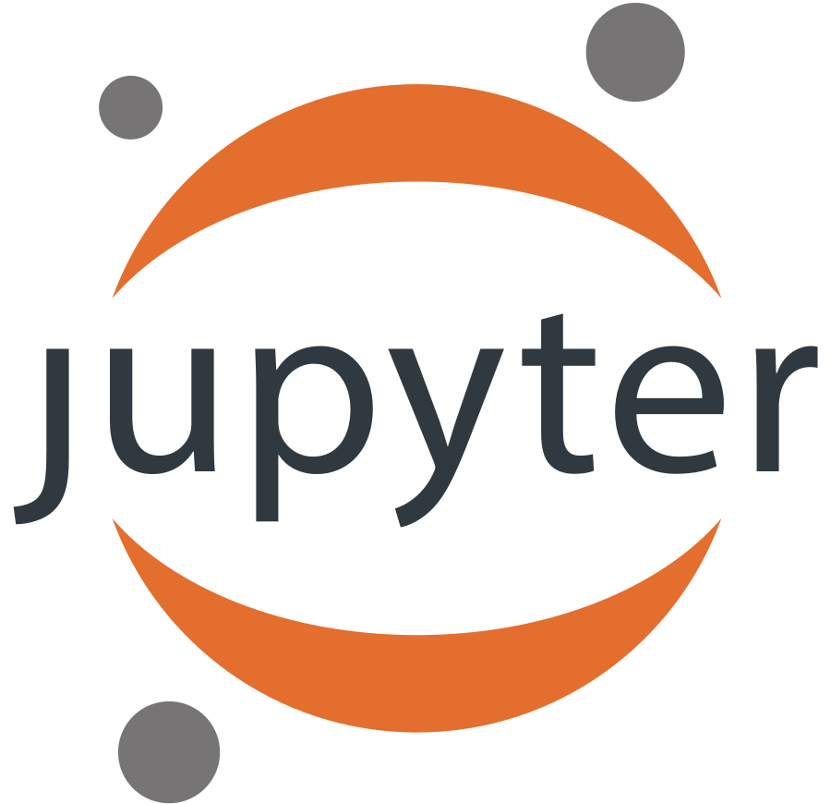


Jupyter and TMVA
Attila Bagoly (Eötvös Loránd University, Hungary)
Mentors:
Sergei V. Gleyzer
Enric Tejedor Saavedra

Slide 2
Motivation
Jupyter notebook:
Interactive coding environment
Document: HTML, Markdown support
Shareable: SWAN, nbviewer, binder
Current status of TMVA:
We can’t use TMVAGui
We can read back the classifier outputs and we can make visualizations.
BUT users don’t want to spend time with making visualizations
Integrating TMVA in Jupyter:
Support for TMVAGui in notebooks
New visualizations
Pythonic interface for a bunch of functions
Interaction: changes modify the state of TMVA
HTML formatted output

Slide 3
Code structure
Importing ROOT will import JsMVA, this will register jsmva magic
%jsmva on: JPyInterface inserts new methods to TMVA.DataLoader and TMVA.Factory, overloads some functions with a wrapper, register HTML transformer function
New methods: inserting HTML to cell output, with JavaScript call for JsMVA.js
JsMVA.js using JsROOT to create JavaScript plots

Slide 4
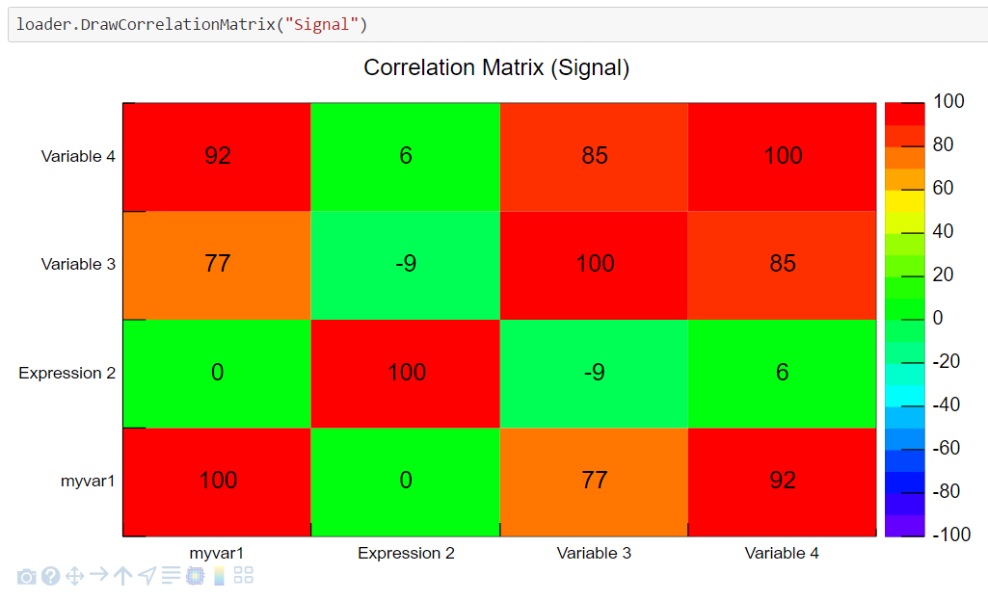
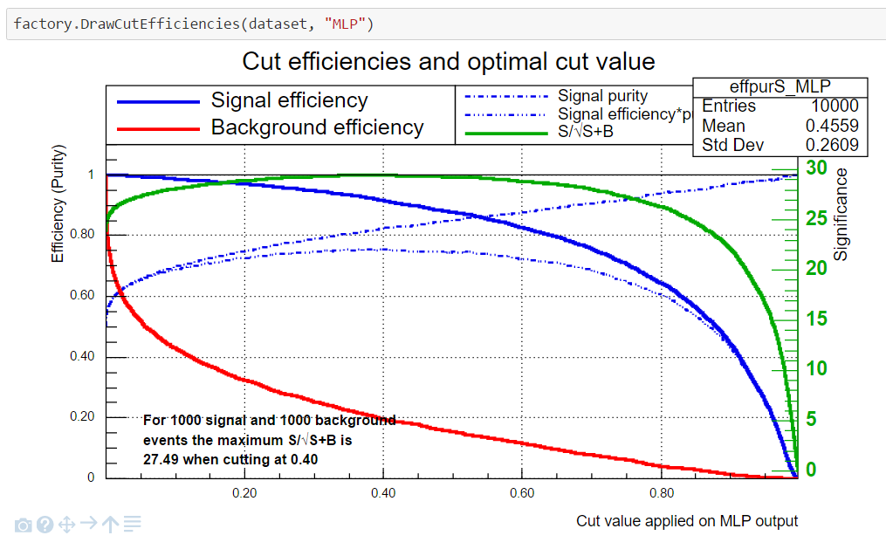
TMVAGui visualizations
Visualizations related to input variables
Correlation matrix
Input variables
Transform input variables & show
Visualizations related to classifier outputs
ROC curve
Output distributions
Cut efficiencies

Slide 5
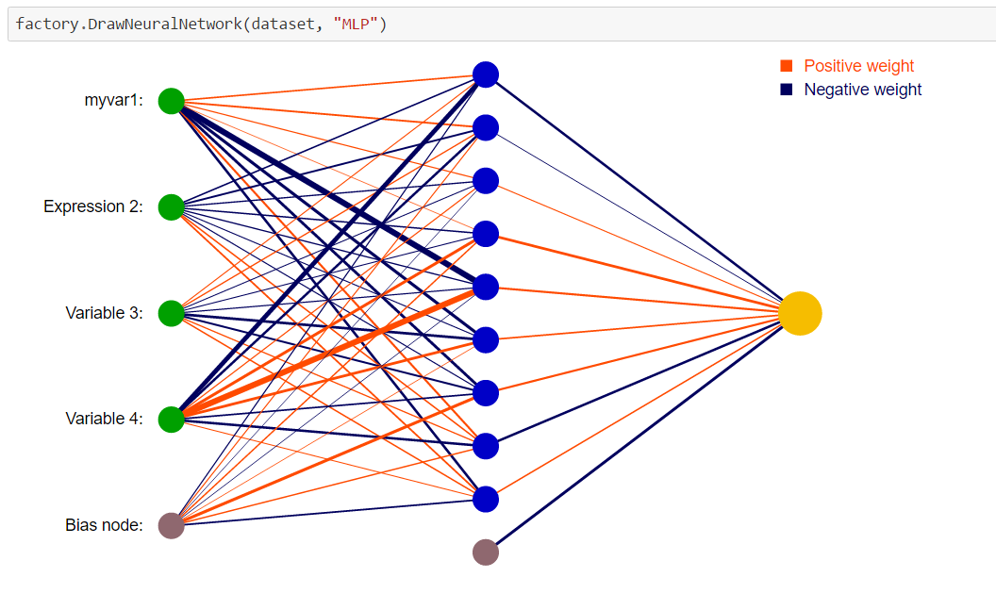
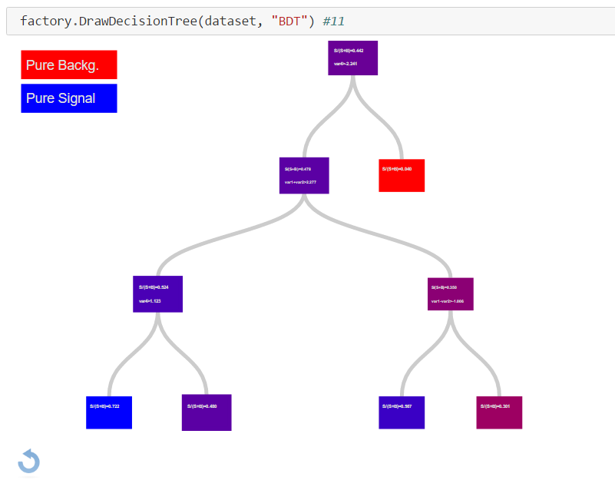
Classifier output: Neural networks, decision trees
Simple neural network
Deep neural network
Decision trees
Python function reads the network, converts to JSON; JS with d3js make the visualization from JSON
Interactive: focusing connections, zooming, moving
HTML5 Canvas visualization (speed)
Less interactive: zooming, moving
Ipywidgets: input field for selecting the tree
Visualization from JSON with D3js
Interactive: closing subtree, showing the path, focusing, moving, zooming, reset

Slide 6
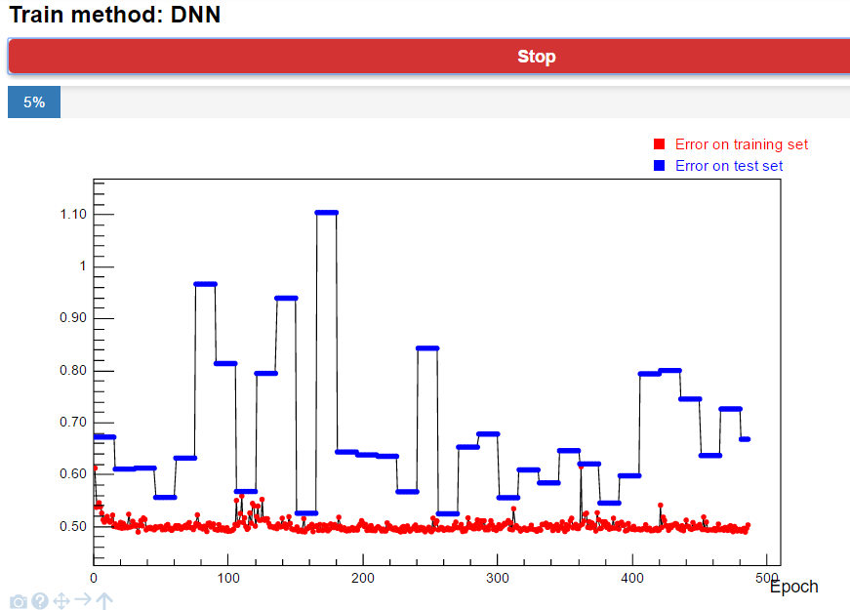
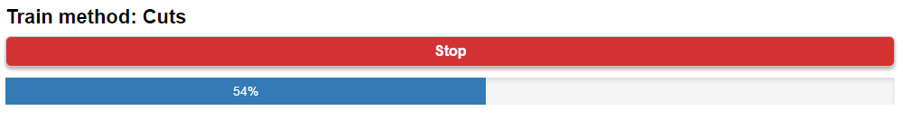
Interactive training mode
C++ interface for tracking/stopping the training
New thread for training
Main thread periodically refreshes the plot (inserts small JS script, which removes itself)
Error plots supported for MLP, DNN, BDT methods
Progress bar for a bunch of methods
Stop button: by clicking on it the main thread will send stop message for training loop (just the loop, no interfere with saving the net, or other data)

Slide 7
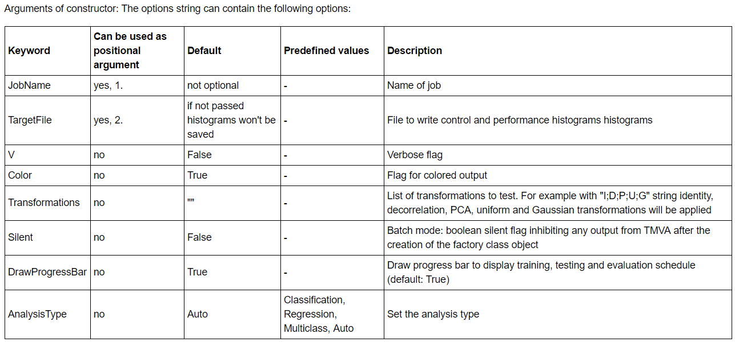
Pythonic user interface, tutorial notebooks
New interface
Option strings not very nice, we can do better in python
Bunch of functions use option string
Wrapper functions for them, with jsmva magic these functions are replaced with corresponding wrapper function
The settings can be passed by named arguments: V=True,Transformations=[“I”,“D”] will be translated to “!V:Transformations=I,D”
Tutorial: http://nbviewer.jupyter.org/github/qati/GSOC16/blob/master/notebooks/ROOTbooks-TMVA-JsMVA-UserInterface.ipynb

Slide 8
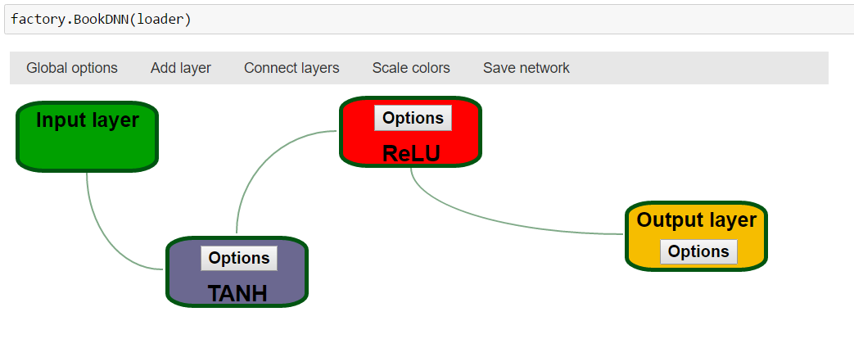
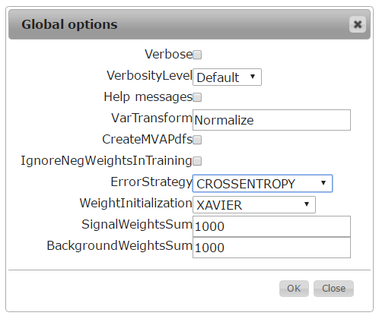
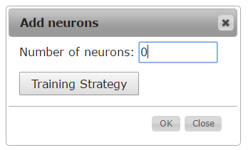
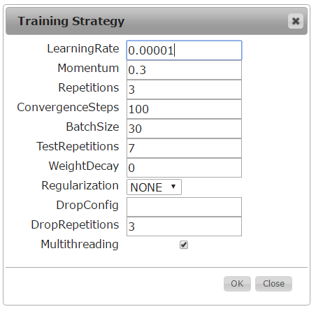
Deep neural network builder
Booking DNN confusing: lot of settings, everybody forgets the exact names
Graphical interface: booking DNN with pleasure
We can add different types of layers
Specify the neuron number and training strategy for layer
Connect the layers: building the network
Save network: transform the graphical representation to option string and books the method

Slide 9
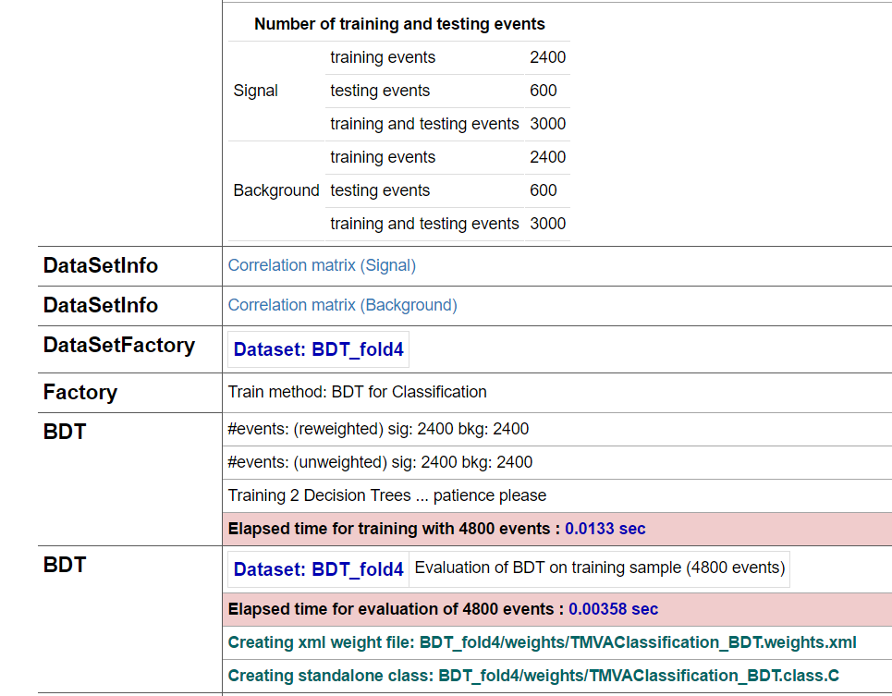
HTML formatted output
jsmva magic register output transformer function to JupyROOT
also inserts CSS (for transformed output tables style) to notebook
The output transformer class:
Regular expressions for matching different output lines => logical units
Based on matchings the output is transformed to table structure (style: CSS)
Correlation matrix: table => histogram => JsROOT visualization in popup window (jquery)

Slide 10
Notebooks
Everything on GitHub:
https://github.com/qati/GSOC16
Notebooks on nbviewer (static, rendered):
http://nbviewer.jupyter.org/github/qati/GSOC16/blob/master/index.ipynb
Notebooks on binder (interactive):
www.mybinder.org/repo/qati/GSOC16
Or you can download:
https://github.com/qati/GSOC16/tree/master/notebooks

Slide 11
Thank you for your attention!

